Slide 1
Steel Image Segmentation
Progress Report
Bishal

Slide 2

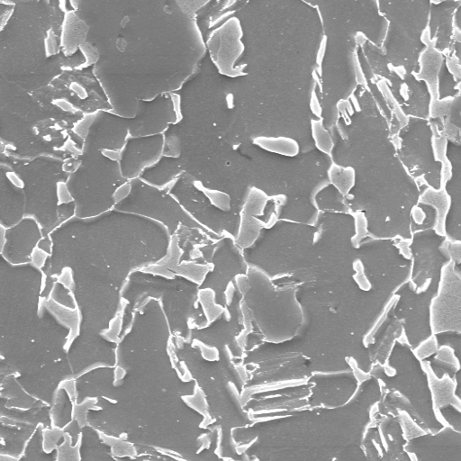
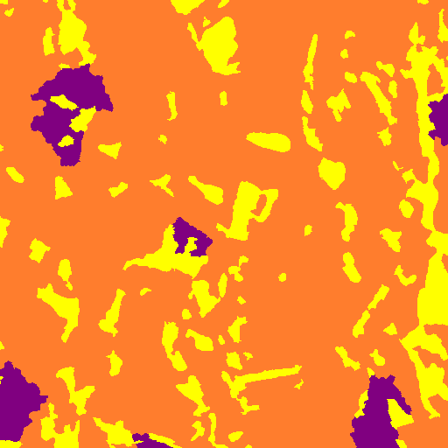

Model Output [old]
Input Test Image
Input Label Image
Output Test Image
Validation mIOU → 0.491552 0.481737
Validation Acc → 97.96 97.44
Test Accuracy → 91.99
Dice Coefficient → 0.922 (avg of 48 test images)
Traning mIoU → 0.494630
Training Acc → 98.91

Slide 3
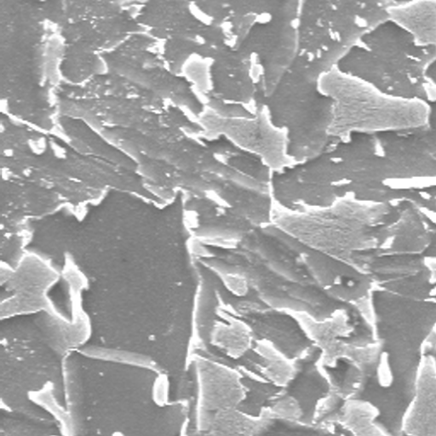
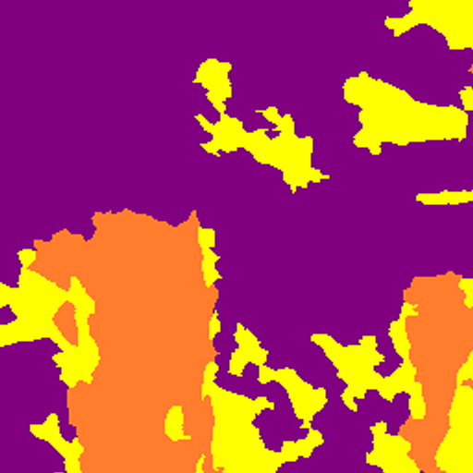
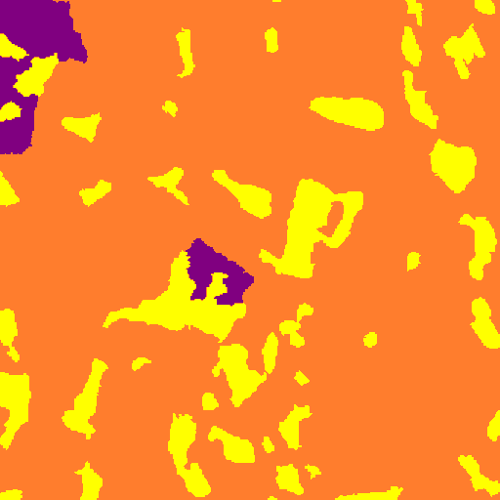
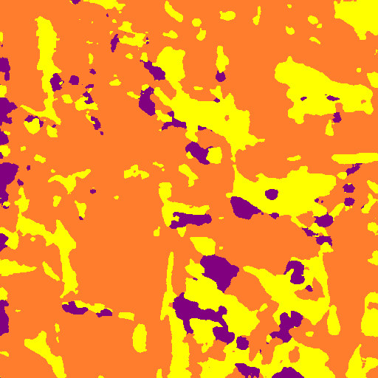
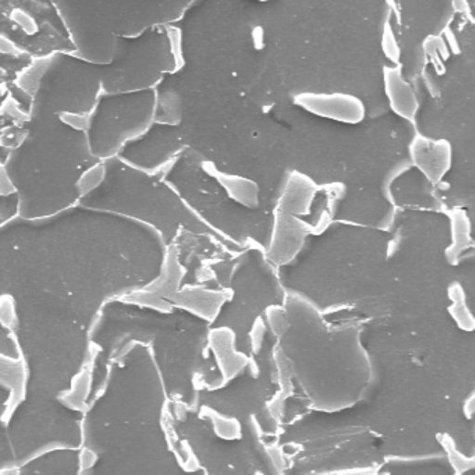
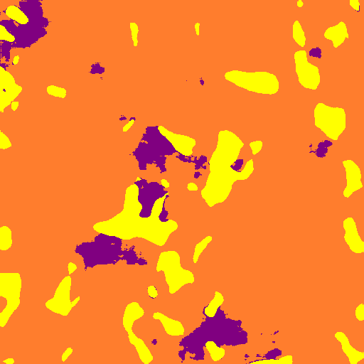
Model Output [new]
Input Test Image
Input Label Image
Output Test Image
Validation mIOU → 0.1734
Validation Acc → 56.87 (Data Imbalance while splitting?)
Test Accuracy → 82.99
Dice Coefficient → 0.81350676 (avg of 48 test images)
Traning mIoU → -
Training Acc → 91.68

Slide 4
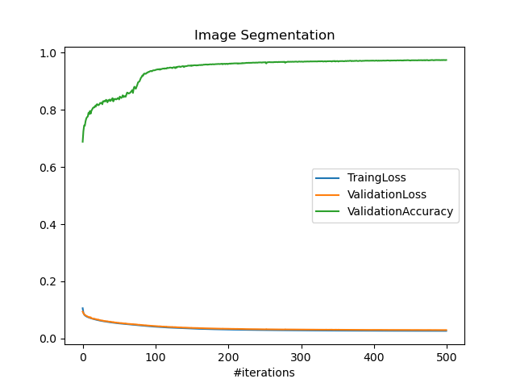
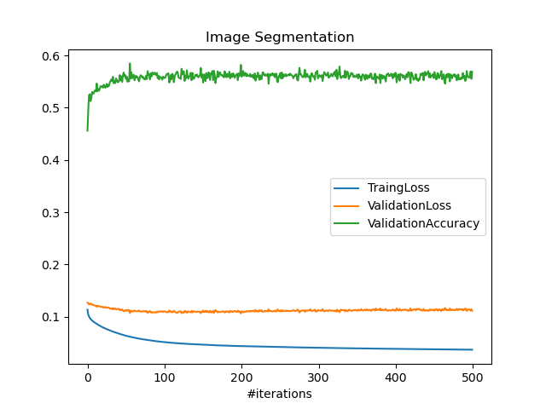
Model Performance

Slide 5
Testing on other type of steel data
x3000
x5000
typeA
typeB
typeC
Previous
Previous
58.85
28.82
46.29
73.61
34.48
New
75.81
83.29
74.83
55.9
69.94

Slide 6
Observation
There were some performance improvements compared to last results.
I mistakenly augmented all the images, so no original images were used for training so the validation and type2 steel suffered during classification .
Magnification, sliding window, random Intensity, random gamma, random noise, and rotation up to 10 degrees were used was using to generate images.
While training the model, 11724 images were used as train images, 213 images were used for validation, 48 images were used for testing.

